Slide 1



COVID Contact-Tracing:
Campus Wifi
Lab exercises: installing R/ Rstudio, beginning to work with data: Data Frames, populations, filtering, distributions...
Ahmed Eleish
ITWS-4600/ITWS-6600/MATP-4450/CSCI-4960 MGMT4962/6962/ BCBP4962
Lab 01, January 24th, 2025
Tetherless World Constellation
Rensselaer Polytechnic Institute
Emily Hu, Freling Smith, Kara Kniss, Ti Dinh, Varun Nair, Yichen Li
The Rensselaer IDEA
Rensselaer Polytechnic Institute
Notes:
0

Slide 2
Lab tasks
• Installations
• Data Frames in R
• Exploring data and their distributions
• Fitting distributions

Slide 3
Objectives for today
• Get familiar with:
– R (Data Frames)
– Populations / Filtering
– Distributions
– Fitting

Slide 4
Gnu R
http://lib.stat.cmu.edu/R/CRAN/ - load this first
http://cran.r-project.org/doc/manuals/
http://cran.r-project.org/doc/manuals/R-lang.html
R Studio – (see R-intro.html too)
https://www.rstudio.com/products/rstudio/ (desktop version)
Manuals - Libraries – at the command line – library(), or select the packages tab, and check/ uncheck as needed

Slide 5
Creating Data Frames in R
Using the data.frames() in R, we can create the data frames Read the documentation for data.frame in Rstudio,
Using the help(data.frame)

Slide 6
Data frames

Slide 8
Table: Matlab/R/scipy-numpy
http://hyperpolyglot.org/numerical-analysis

Slide 9
Exercises – importing data
• Rstudio
– read in csv file (two ways to do this) - filename.csv
– Read in excel file (directly or by csv convert) - filename.xls
– Plot some variables
• Also for other datasets, enter these in the R command window panel or cmd line
> data()
> help(data)

Slide 10
Files
Here -> https://rpi.box.com/s/5yjvz1x7kha7cqwmyrg6aztksfo9lksi
epi2024results06022024.csv
Get the data read in (in e.g. use “EPI_data” for the object (in R))
> EPI_data <- read.csv(“<path>/epi_2024_results_DAF24.csv”)
# Note: replace default data frame name – cannot start with numbers! Munging has begun! (ugh)
# Note: replace <path> with either a directory path or use:
> setwd(“<path>”)
> EPI_data <- read.csv(“epi_2024_results_DAF24.csv”)
> View(EPI_data)

Slide 11
Tips (in R)
> attach(EPI_data) # sets the ‘default’ object
> EPI.new # prints out values EPI_data$EPI.new
[1] "30.7" "52.1" "41.9" "39.7" "55.5" "46.8" "44.7" "63" "69" "40.4" "56" "35.9"
[13] "27.8" "53.1" "58.1" "66.7" "47.4" "37.4" "43.3" "44.9" "45.6" "49" "53" "48.5"
[25] "56.3" "41.5" "33" "37.9" "31" "38.1" "61.1" "38.3" "35.2" "50" "35.5" "49.4"
[37] "37.9" "55.5" "42.5" "62.6" "52.3" "54" "65.6" "39" "67.9" "32.2" "49.2" "47.6"
[49] "51.2" "43.8" "41.5" "41.6" "28.6" "75.3" "38.5" "35.8" "45.8" "73.7" "67.1" "53.1"
> NAs <- is.na(EPI.new) # records True values if the value is NA
> EPI.new.noNAs <- EPI.new[!NAs] # filters out NA values, new array

Slide 12
Data Cleaning, etc.
• Bad values, outliers, corrupted entries, thresholds ...
• Noise reduction – low-pass filtering, binning
• REMEMBER: when you clean you MUST record what you did (and why) and save copies of data/code pre- and post- operations...

Slide 13
Exercise 1: exploring the distribution
> summary(EPI.new) # stats
Min. 1st Qu. Median Mean 3rd Qu. Max. NA's 32.10 48.60 59.20 58.37 67.60 93.50 68
> fivenum(EPI.new,na.rm=TRUE) [1] 32.1 48.6 59.2 67.6 93.5
> stem(EPI.new) # stem and leaf plot
> hist(EPI.new)
> hist(EPI.new, seq(20., 80., 1.0), prob=TRUE)
> lines(density(EPI.new,na.rm=TRUE,bw=1.)) # or try bw=“SJ”
> rug(EPI.new)
#Use help(<command>), e.g. > help(stem)

Slide 14
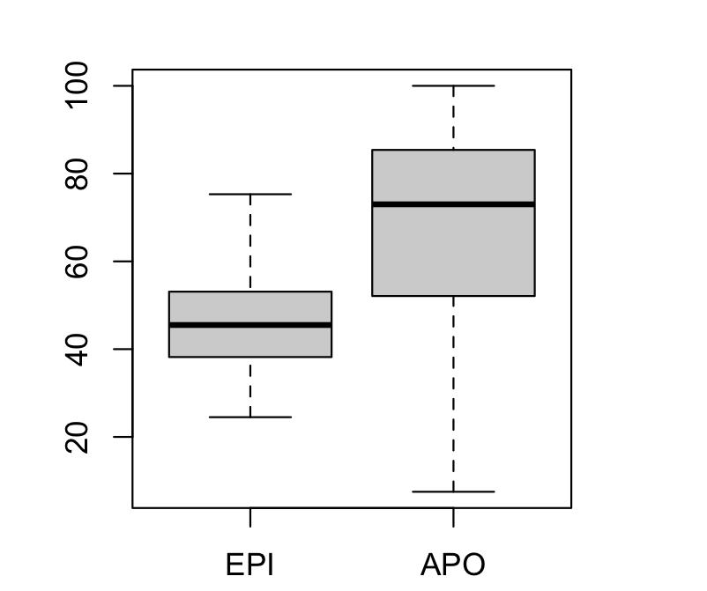
Comparing distributions
> boxplot(EPI.new, APO.new)

Slide 15
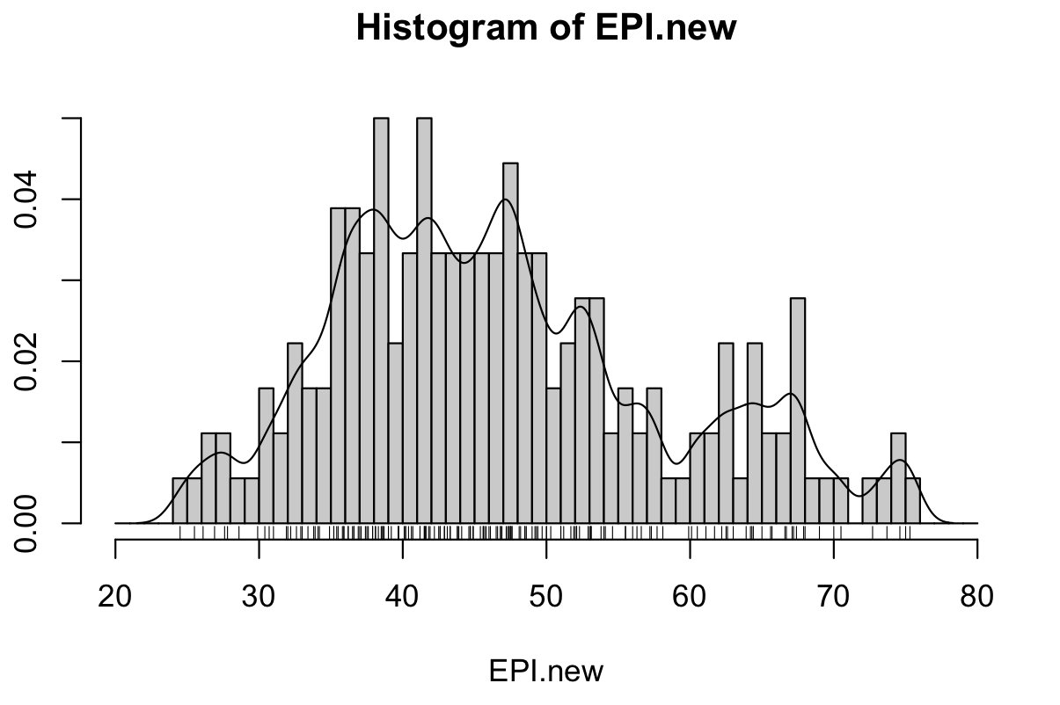
> hist(EPI.new, seq(20., 80., 1.0), prob=TRUE)
> lines (density(EPI.new,na.rm=TR UE,bw=1.))
> rug(EPI.new)

Slide 16
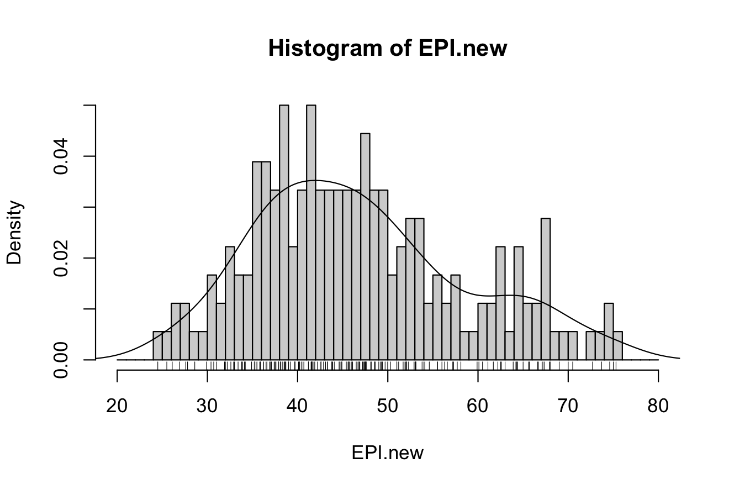
> hist(EPI.new, seq(20., 80., 1.0), prob=TRUE)
> lines (density(EPI.new,na.rm=TRUE,bw=“SJ”))
> rug(EPI.new)

Slide 17
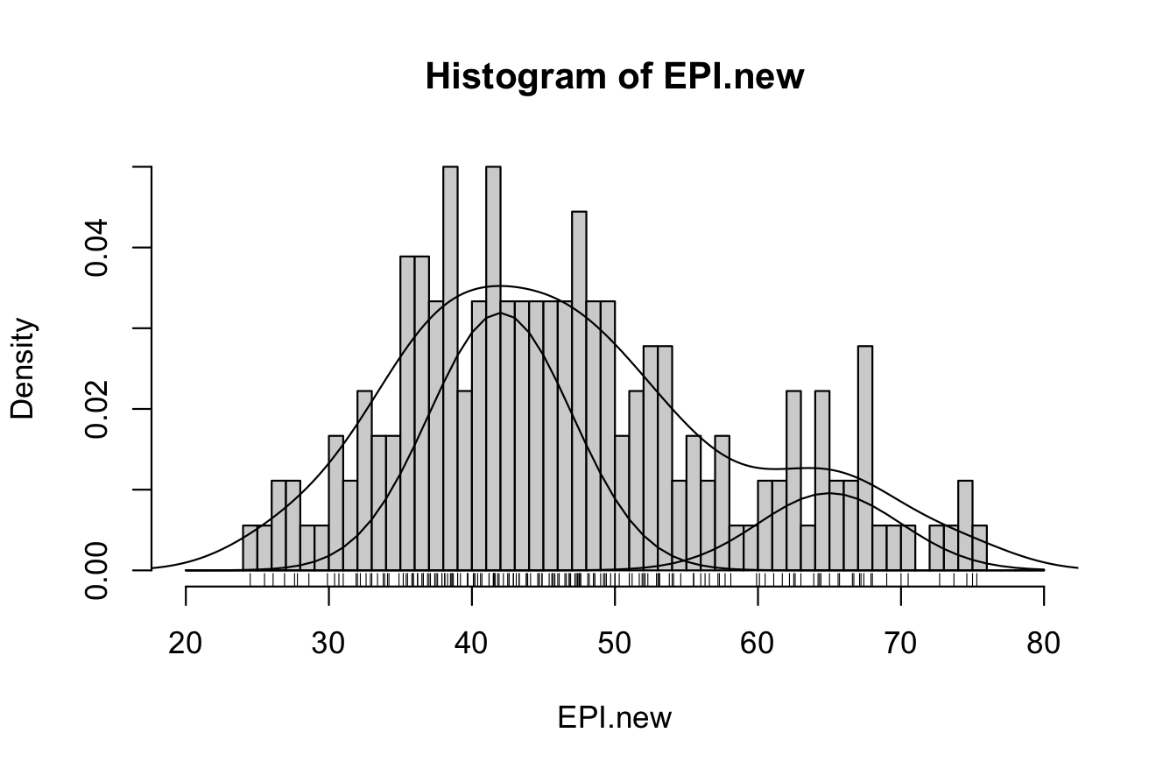
Why are histograms so unsatisfying?

Slide 18
> x<-seq(20,80,1)
> q<- dnorm(x,mean=42, sd=5,log=FALSE)
> lines(x,q)
> lines(x,.4*q)
> q<-dnorm(x,mean=65, sd=5,log=FALSE)
> lines(x,.12*q)

Slide 19
Exercise 2: fitting a distribution beyond histograms
• Cumulative density function?
> plot(ecdf(EPI.new), do.points=FALSE, verticals=TRUE)
• Quantile-Quantile?
> qqnorm(EPI.new); qqline(EPI.new)
• Make a Q-Q plot against the generating distribution by:
> qqplot(rnorm(250), EPI.new, xlab = "Q-Q plot for norm dsn")
> qqline(EPI.new)
> qqplot(rt(250, df = 5), EPI.new, xlab = "Q-Q plot for t dsn")
> qqline(EPI.new)

Slide 20
Exercise 2a: fitting a distribution
Your exercise: do the same exploration and fitting for another 2 variables in the EPI dataset, i.e. primary variables (APO, WRS, etc.)

Slide 21
Push your Lab code to Github
• Please create a folder for Lab1 in your Github repository and push your code/plots.

Slide 22
Next Class:
January 28th - Naive Bayes, decision trees, kNN, k-means

Slide 23
Thanks!
Have a great weekend!!!

